Slide 1
WRITING A DBQ:
AP* U.S. History

Slide 2
What Is a DBQ?
An essay question that asks you to take a position on an issue that has several possible answers
No “right” or “correct” response
You must craft a thesis based on your own knowledge and your interpretation of the evidence presented
Notes:
A DBQ is an essay question that asks you to take a position on an issue that has several possible answers. There is no “right” or “correct” response. The question is designed to give you the opportunity to craft and defend a thesis based upon your knowledge and your interpretation of the evidence presented to you in the primary sources and other documents.

Slide 3
What Is a DBQ?
You will need to combine your outside historical knowledge and a significant amount of knowledge gleaned from the documents to demonstrate your ability to craft an argument.
Notes:
There will be one document-based-question on the exam. It will have one of the following historical thinking skills as its main focus: causation, change and continuity over time, comparison, interpretation, or periodization.
All DBQs will also always assess the historical thinking skills of historical argumentation, appropriate use of relevant historical evidence, contextualization and synthesis.
Expectations:
In Your response you should do the following:
State a relevant thesis that directly addresses all parts of the question
Support the thesis or a relevant argument with evidence from all, or all but one, of the documents
Focus the analysis of each document on at least one of the following: intended audience, purpose, historical context, and/or point of view.
Support your argument with analysis of historical examples outside the documents.
Connect historical phenomena (events, people, processes) relevant to your argument to broader events or processes.
Synthesize (combine) the elements above into a persuasive essay

Slide 4
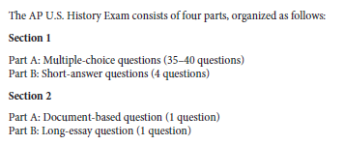
Structure of AP Exam

Slide 5
Prompt Analysis Format: A 5 Step Method

Slide 6
Step 1 – Attack the Prompt
Read the question carefully, a few times, then think about the following:
What is the essence of the question?
Be sure to know exactly what the question is asking you.
Notes:
First, read the question carefully and try to determine the essence of the question. For example, what type of question is it: What historical skill is it testing?
causation,
Compare causes and/or effects, including between short and long term effects. (I.e. students should move from describing causes to analyzing and evaluating interaction of multiple causes and/or effects).
Analyze and evaluate the interaction of multiple causes and/or effects.
Assess historical contingency by distinguishing among coincidence, causation, and correlation, as well as critiquing existing interpretations of cause and effect.
change and continuity over time,
Recognize, describe, and analyze historical patterns of continuity and change over time (of varying lengths).
Connect patterns of continuity and change over time to larger historical processes of themes.
comparison,
Describe, compare, and evaluate multiple historical developments within one society, one or more developments across or between difference societies, and in various chronological and geographical contexts.
Explain and evaluate multiple and differing perspectives on a given historical phenomenon.
interpretation,
Analyze diverse historical interpretations.
Evaluate how historians’ perspectives influence their interpretations and how models of historical interpretation change over time.
Periodization
Explain ways that historical events and processes can be organized within blocks of time.
Recognize that the choice of a specific period gives a higher value to one historical narrative, region, or groups.
Analyze and evaluate competing models of periodization of US history.

Slide 7
Step 2 - The Thesis Statement
A positive assertion regarding an issue about which reasonable people may hold different opinions
Answers the question in one sentence
Use your database to organize your arguments
Don’t discuss the documents in the order in which the DBQ presents them
Notes:
A thesis statement is a positive assertion regarding an issue about which reasonable people may hold different opinions. You must have a thesis before you can prove it. Your first paragraph should reflect that you have a thesis and that you understand the complexity of the question. Remember, there are no simple answers to a DBQ—if an easy response existed, the question wouldn’t have been asked in the first place. The level of sophistication of your analysis and the degree to which you successfully prove your thesis are crucial in receiving a high score.

Slide 8
Step 3 - Analyzing the Documents
A document is not a fact, but a piece of evidence to interpret
Point of view is crucial – is there anything about the doc that is a red flag – i.e. the author, the time, the place, etc.?
Briefly write the main point of each document in your own shorthand.
HIPPO
The “O” is how you might use the document in your essay.
Notes:
The analysis of the documents should provide evidence to support the thesis.
While evidence from at least 6 documents must be included, the essay should incorporate more in-depth analysis of at least four documents (i.e. a MAJORITY of the documents provided) – examining
Point of view
Intended audience
Purpose
A strong essay, however, does not simply list the characteristics of one document after another. Instead, it makes connections between documents or parts of documents to craft a convincing argument.
A good essay would observe that the documents also reflect differences in point of view, audience, format, etc.

Slide 9
Step 3 - Analyzing the Docs cont.
If the prompt requires you to take one position or another, group the documents on the basis of those positions.
Then think – so what? How might I use this? How does it fit in to my essay? In other words, you will be required to think about what you can INFER from the contents of the document.
Notes:
Outside knowledge might follow up on specific references in the documents.
In other cases, you might use outside knowledge to provide context and demonstrate continuity and change.
The inclusion of knowledge that extends beyond the documents themselves should strengthen the argument and demonstrate an appreciation and awareness of the nuances/complexities/contradictions of history.

Slide 10
Step 3 - Analyzing the Docs cont.
In a Nutshell, when you look at a doc, think about:
Document information (i.e. what the document is about, the purpose, main idea – think of it kind of like a summary)
Document Inferences (i.e. what can you INFER from the documents – how might you use it? Why do you think the AP test makers put this doc there)
Potential Outside Info triggered by the doc (i.e. the doc may help you remember other stuff)

Slide 11
Step 4 – Rough Outline.
This is to be done within the first 15 minutes on test day.
It is a quick outline that is not graded, and should consist of your own shorthand.
It should provide a sketch of each paragraph – its purpose and/or main argument, the docs you will use, and the outside knowledge you will use

Slide 12
Step 5 – write the essay (finally!!) The First Paragraph
Make a strong first impression
The reader should know your position on the question unequivocally after the first paragraph
Notes:
In the first paragraph of your essay, you need to provide insight (that is, analysis, perspective, and point of view) into the complexity of the question. This is particularly important if you want to get the highest essay scores. You should make a strong first impression. Try to impress the reader with your analysis of the question. Above all, the reader should know your position on the question unequivocally after the first paragraph.
O’Brien Special - Your opening paragraph should contain the following:
A brief definition of the terms and parameters as you understand them
Insightful commentary on the question and its complexity
Your thesis (MAKE IT NUANCED – RESTATES THE QUESTION BUT ALSO INTRODUCES YOUR RATIONALE/REASONS)

Slide 13
The Body of the Essay (continued)
Stick to the facts
Make sure that each point you make supports your thesis and is substantiated by historical evidence.
Include outside information
Cite a majority, MAYBE ALL, of the documents
Notes:
Don’t editorialize. Stick to the facts. Think of the essay like a sports broadcast: you need to provide the color analysis, not the play-by-play. Instead of saying, “Johnson strikes out,” you need to say, “Johnson has proven again and again that he can’t handle an inside fastball.” When you make a point, be sure that it links to your thesis and supports it. When you finish a paragraph, look back and make sure it connects with your thesis. In addition, you need to provide a substantial amount of outside information and cite a majority of the documents in your essay.

Slide 14
Prompt Analysis Format: Summary
Attack the PROMPT
Write tentative THESIS
Analyze DOCS
Write rough and quick OUTLINE
Write the DBQ

Slide 15
DBQ Facts & Tips
Synthesize the information that is in the documents rather than paraphrasing or quoting the documents.
In other words, use the main idea of any document to support your thesis, don’t rely too heavily on quoting it. (perhaps use excerpts that are within YOUR text.
Documents are meant to trigger recollection of relevant outside information to include in your responses.

Slide 16
DBQ Facts & Tips
Be prepared to write a “concession paragraph” just before the conclusion. A concession paragraph acknowledges challenges and conflicts to your thesis. Although this paragraph should never REPUDIATE (i.e. negate) your thesis, its inclusion in your essay demonstrates that you are attuned to the complexity and controversy that may surround the issues in your answer.

Slide 17
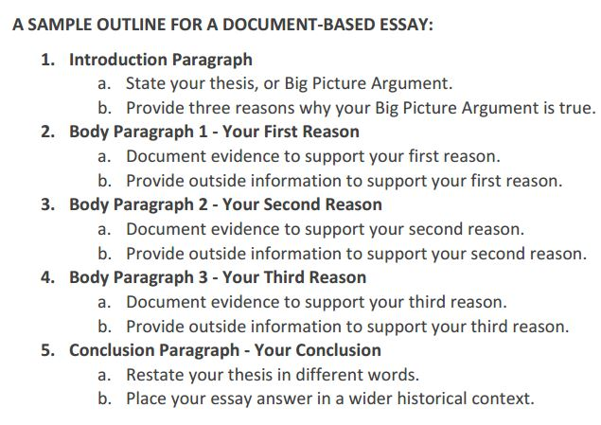
Revisit your THESIS and Start your Intro
Notes:
Now you are ready to revisit your thesis, You should provide evidence of both, but pick a side. Remember, every issue has contradictions – you are to highlight them, and come to a clear conclusion.
Perhaps jot down a rough outline of the body paragraphs.
Write an introductory paragraph with a clear thesis that answers the question in one sentence.

Slide 18
DBQ #1

Slide 19
Question
“The Constitution represents the subversion of the Revolution.” Assess the validity of the statement.

Slide 20
Goals/Values of Rev.
republicanism: people are virtuous; England is corrupt; gov’t doesn’t need to be strong and centralized
consent of the governed; no taxation w/o representation
all men are created equal (equality of opportunity)
unalienable rights: life, liberty, property
grievances (taxation, standing army)
protect economic interests (property)
Outside Knowledge
Notes:
Here are some examples of things you might include in the “goals and values of the Revolutionary Era” section of the database. After all, you need to explain what they were if you are to then argue that they were, or were not, subverted.

Slide 21
Yes Const. subverts
reliance on institutions demonstrates loss of faith in the virtue of the people—demonstrates that Const is anti-republican
possible oligarchic nature of a consolidated gov’t (e.g. Senate, power of judiciary, large voting districts for house)
representation is distant in an extended republic
good of the whole (Const. is individualistic)
A of C should be seen as a representation of the values of the Rev: gov’t doesn’t need to be strong and centralized, b/c people are virtuous; Const. obviously subverts the spirit of the A of C.
Notes:
Some OK you may want to include in the “Constitution does subvert the Revolutionary Era” section of our database.

Slide 22
No, Const. doesn’t subvert
liberty won in Rev can only be protected by a strong central gov’t – i.e.:
Articles have/will fail:
regional conflicts will be irreconcilable;
foreign trade languishes;
geopolitical threats will overwhelm
reduces impact of factions (i.e. promotes stability)
economic interests of wealthy were protected, not subverted, by Const. (Progressive view)
Const wasn’t subversion, it was evidence of having learned from experience…classical republicanism didn’t work that well in practice, needed to be replaced by liberal worldview—so Const. was actually saving liberty
Notes:
Some OK you may want to include in the “Constitution does not subvert the Revolutionary Era” section of our database.

Slide 23
Document A
Source: Amos Singletree, 1788.
These lawyers, and men of learning, and moneyed men, that talk so finely, and gloss over matters so smoothly, to make us poor illiterate people swallow down the pill, expect to get into Congress themselves...and then they will swallow up all us little folks, like the great Leviathan
Notes:
This document shows that

Slide 24
Document B
Source: Richard Henry Lee, 1787
It cannot be denied with truth, that this new constitution is, in its first principles, most highly and dangerously, oligarchic.
Notes:
In this document, Mrs. Barney levels withering criticism of the Jacksonian spoils system. She claims that he merely swept out his political opponents while allowing his supporters to get away with improprieties.

Slide 25
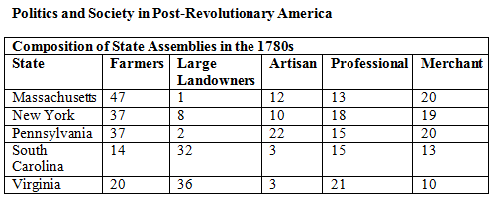
Document C
Source: Chart: Composition of State Assemblies in the 1780’s, Gilder Lehrman Institute of American History.

Slide 26
Document D
Source: Speech on the Constitutional Convention on a Plan of Government, Alexander Hamilton, 1787
All communities divide themselves into the few and the many. The first are the rich and well born, the other the mass of the people.... The people are turbulent and changing; they seldom judge or determine right. Give therefore to the first class a distinct, permanent share in the government. They will check the unsteadiness of the second, and as they cannot receive any advantage by change, they therefore will ever maintain good government.

Slide 27
Document E
Source: Democracy in America, Alexis de Tocqueville, 1835.
The doctrine of self-interest properly understood does not inspire great sacrifices, but every day it prompts some small ones; by itself it cannot make a man virtuous, but its discipline shapes a lot of orderly, temperate, moderate, careful, and self-controlled citizens. If it does not lead the will directly to virtue, it established habits which unconsciously turn it that way.

Slide 28
Document F
Source: Interpreting the Founding, 2nd Edition, Alan Gibson, 2009.
[Historian Paul Rahe’s] analysis…shows that the early moderns developed a “new science of politics” that was predicated on radically different beliefs than classical republicanism and sought to achieve radically different ends. Whereas the ancients had believed with Aristotle that man is a political animal…the moderns envisioned a …”state of nature” in which man in his essence was free, equal, independent and dominated by a concern for self-preservation and material comfort. Whereas ancient philosophers had believed that moral reason could restrain bodily desires and logos could result in agreement about the proper goals or ends of life, the moderns… believed that speech was more likely to become the catalyst of war than of unity and that reason was enslaved by the passions, and was best suited merely to calculate the means to indeterminate and unlimited ends…

Slide 29
Document G
Source: Antiquity Surpassed, Paul Rahe, 1994.
[In two letters to Mercy Otis Warren in January and April 1776, John Adams writes]
There must be a positive Passion for the public good, the public Interest, Honour, Power, and Glory, established in the Minds of the People, or there can be no Republican Government, nor any real Liberty. And this public Passion must be Superiour to all private Passions. Men must be ready, they must pride themselves, and be happy to sacrifice their private Pleasures, Passions, and Interests, nay their private Friendships and dearest Connections, when they stand in Competition with the Rights of society.
[Rahe adds of Adams] He was afraid that the “rage for Profit and Commerce” so evident “among all ranks and Degrees of men even in America” would be fatal to liberty’s cause for he had learned from studying the ancients that “the spirit of Commerce…is incompatible with that purity of Heart, and Greatness of should which is necessary for an happy Republic.” If the Revolution was to succeed, “every Man must seriously set himself to root out his Passions, Prejudices, and Attachments, and to get the better of his private Interest. The only reputable Principle and Doctrine must be that all Things must give Way to the public.”

